Slide 1
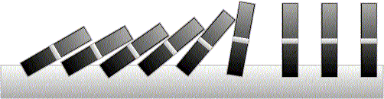
Mathematical Induction

Slide 2
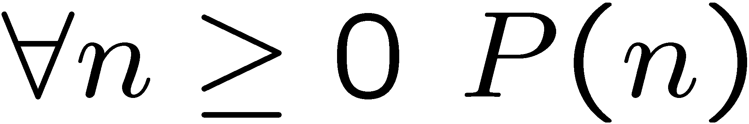
Idea of Induction
Objective: Prove
This is to prove
The idea of induction is to first prove P(0) unconditionally,
then use P(0) to prove P(1)
then use P(1) to prove P(2)
and repeat this to infinity…

Slide 3
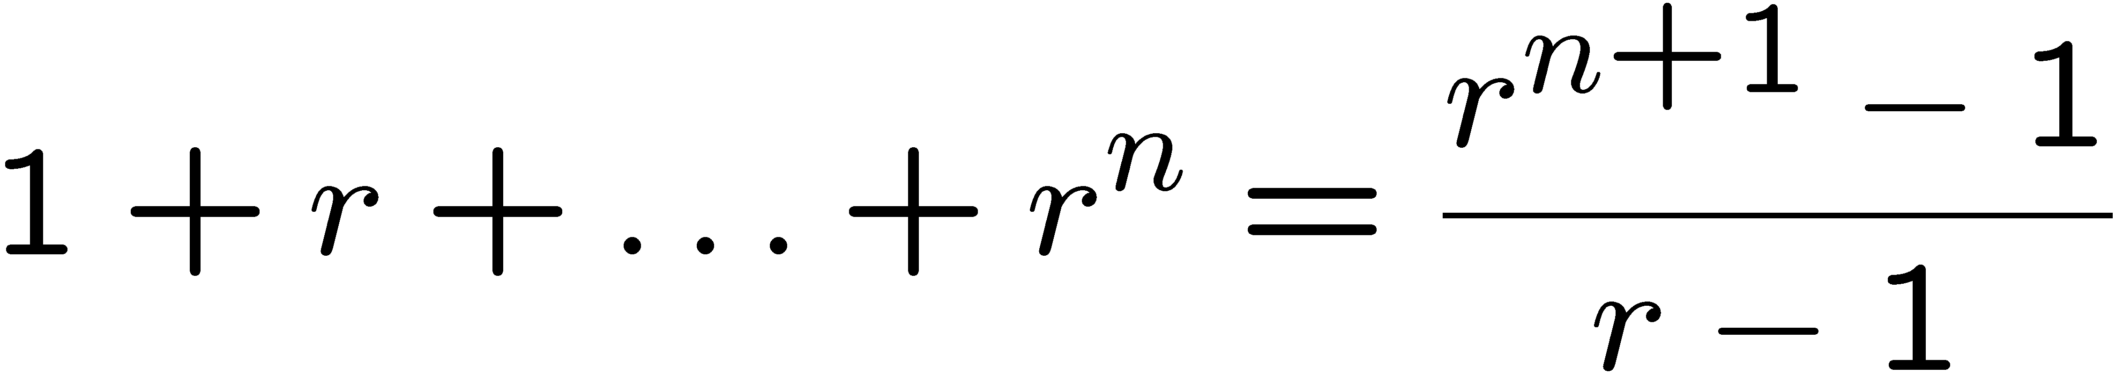
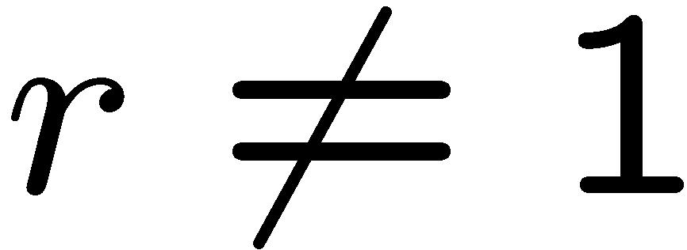
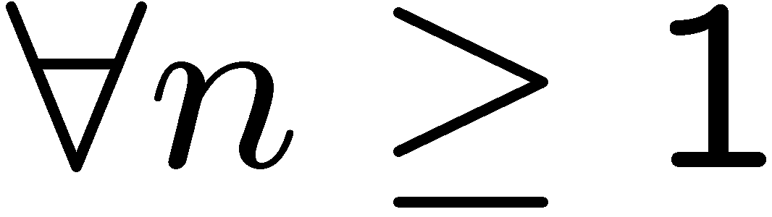
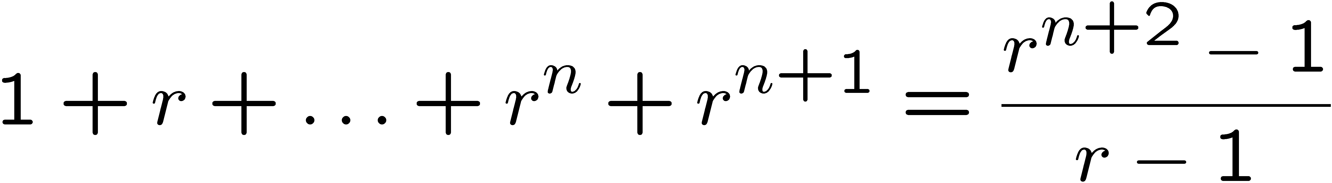
Proving an Equality
Let P(n) be the induction hypothesis that the statement is true for n.
Base case: P(1) is true
because both LHS and RHS equal to 1
Induction step: assume P(n) is true, prove P(n+1) is true.
That is, assuming:
Want to prove:
This is much easier to prove than proving it directly,
because we already know the sum of the first n terms!

Slide 4
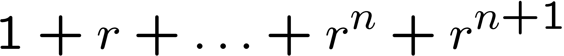
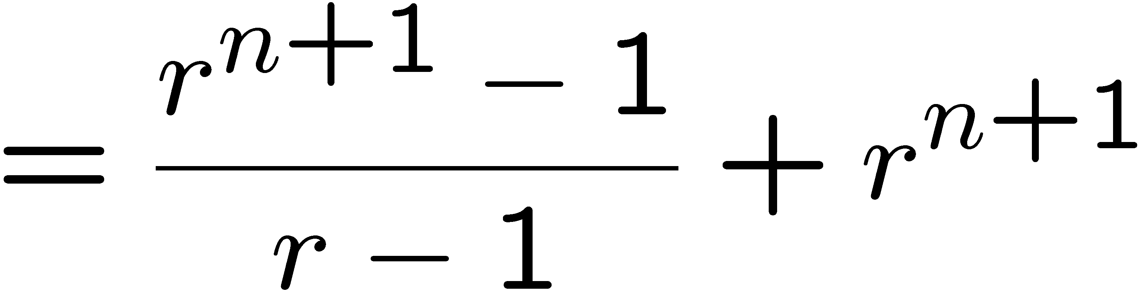
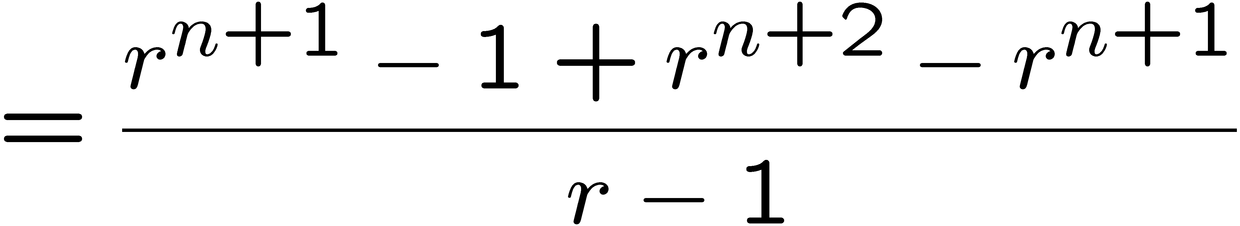
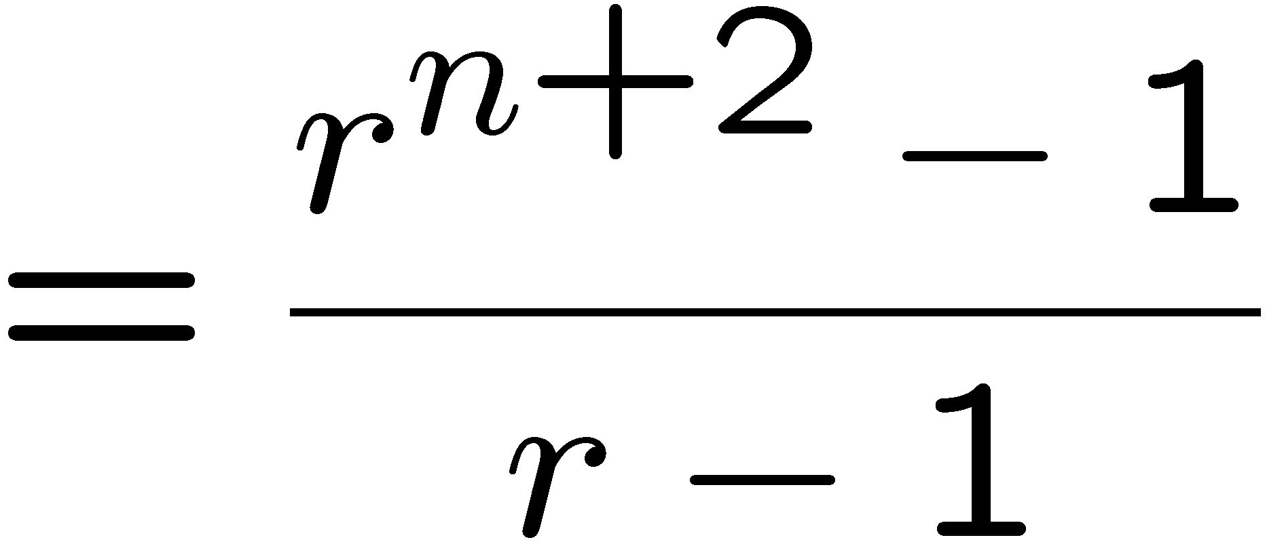
Proving an Equality
Let P(n) be the induction hypothesis that the statement is true for n.
Base case: P(1) is true
because both LHS and RHS equal to 1
Induction step: assume P(n) is true, prove P(n+1) is true.
by induction

Slide 5
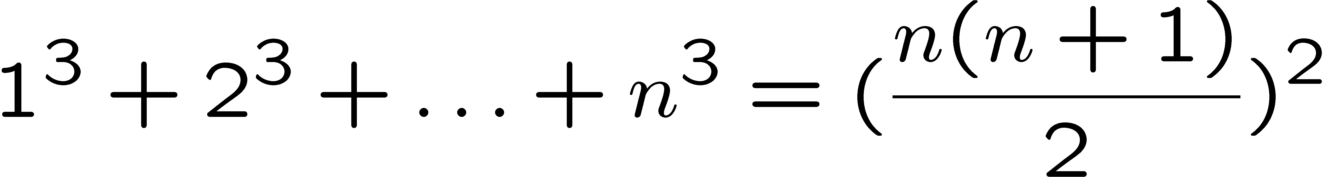
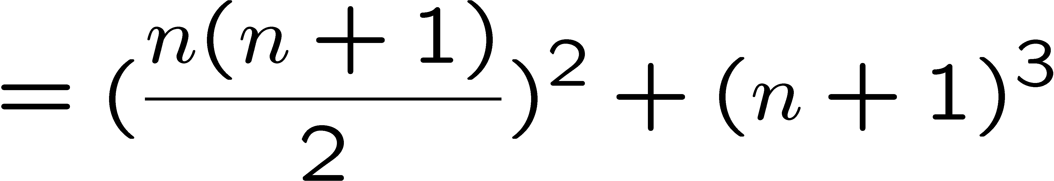
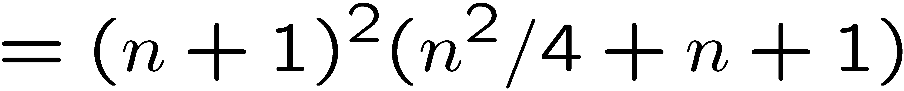
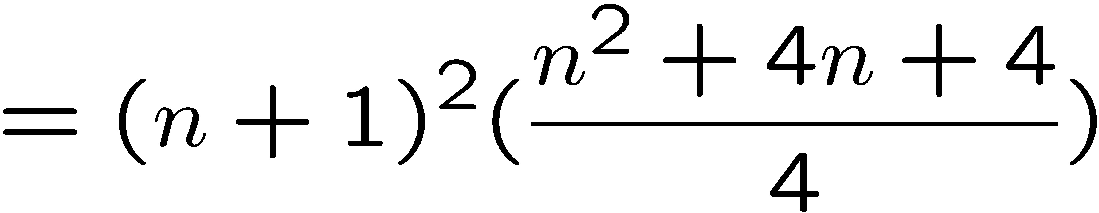
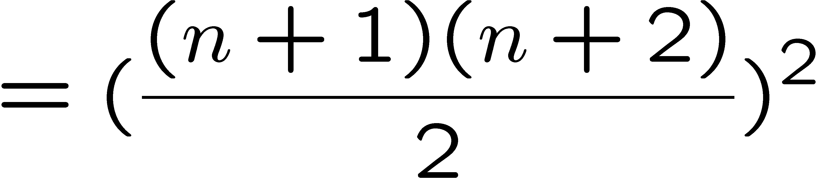
Proving an Equality
Let P(n) be the induction hypothesis that the statement is true for n.
Base case: P(1) is true
Induction step: assume P(n) is true, prove P(n+1) is true.
by induction

Slide 6
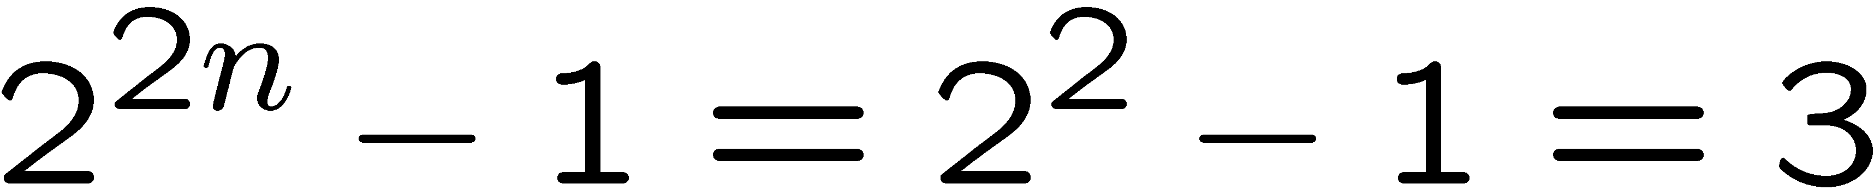
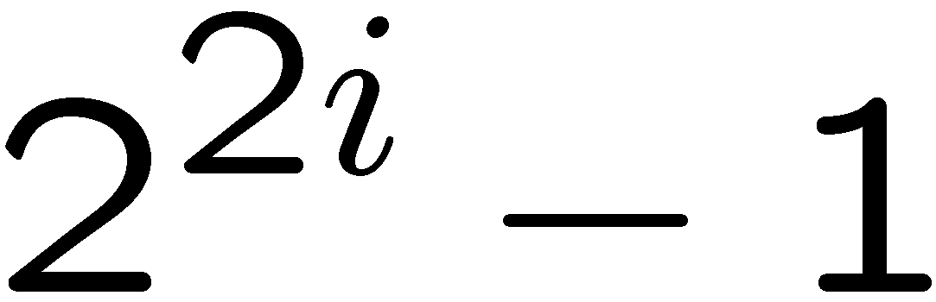
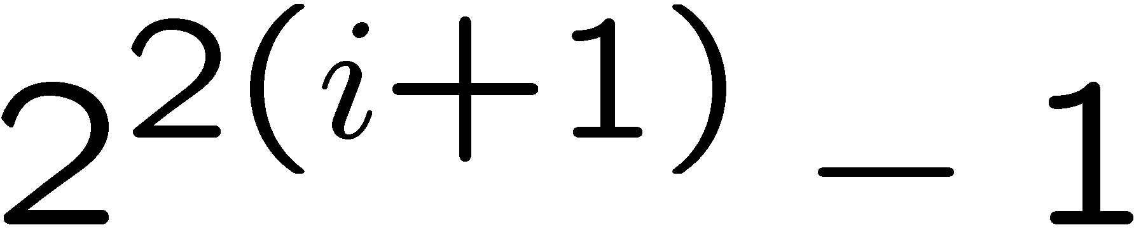
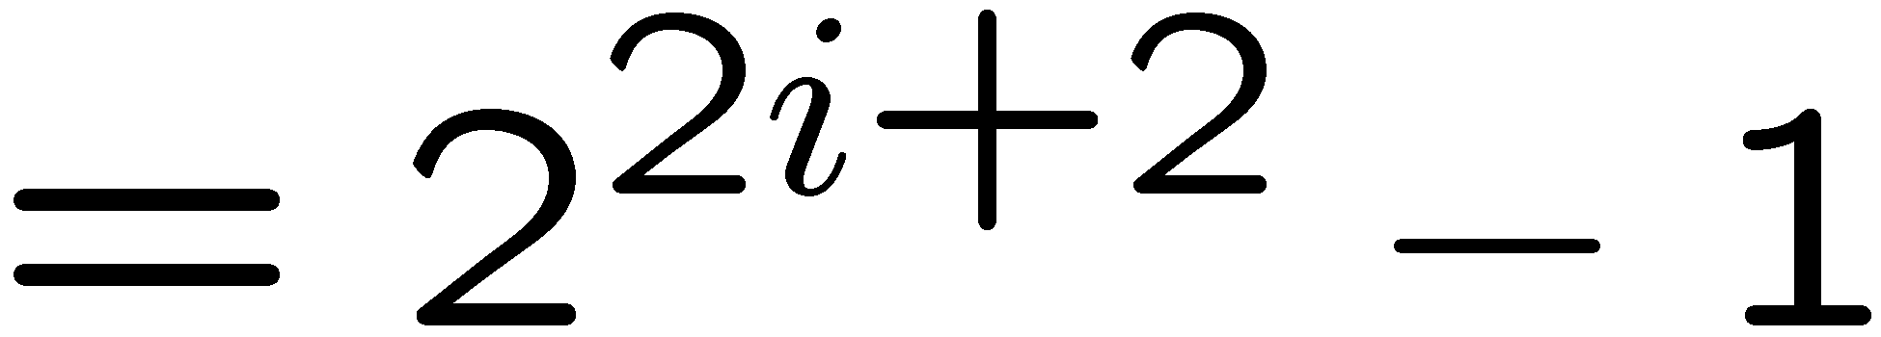
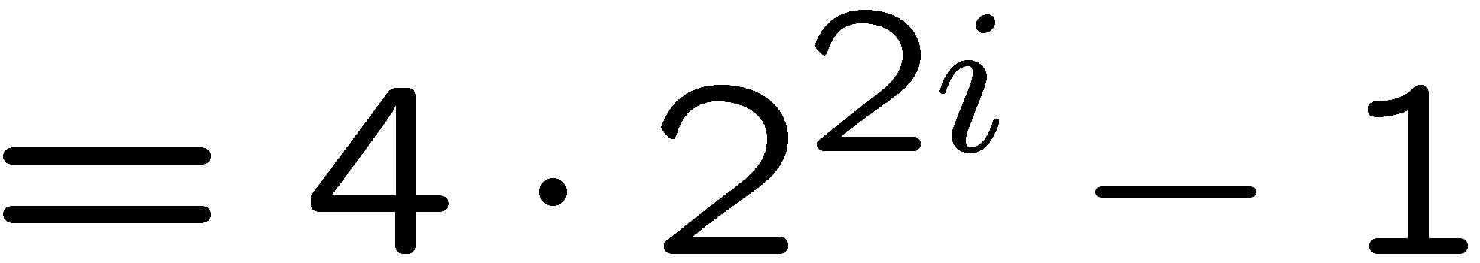
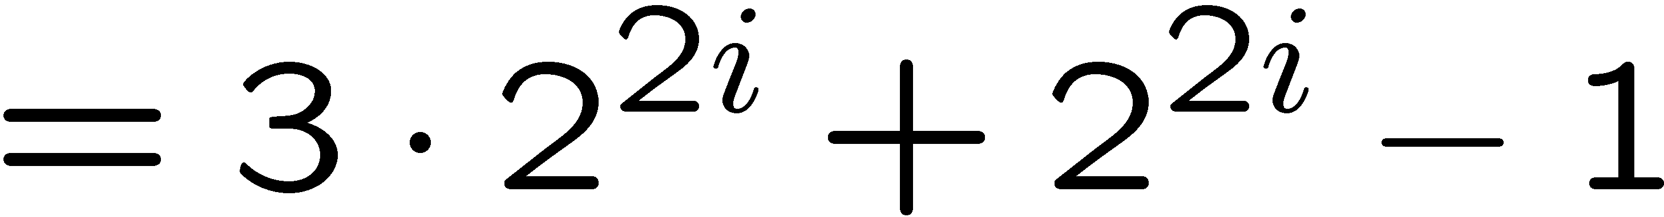
Proving a Property
Base Case (n = 1):
Induction Step: Assume P(i) for some i ≥ 1 and prove P(i + 1):
Assume
is divisible by 3, prove
is divisible by 3.
Divisible by 3
Divisible by 3 by induction

Slide 7
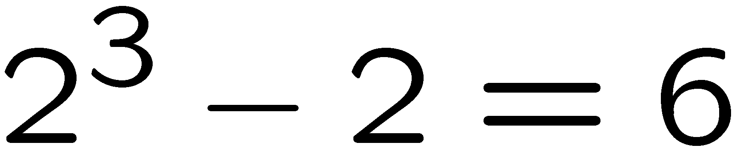
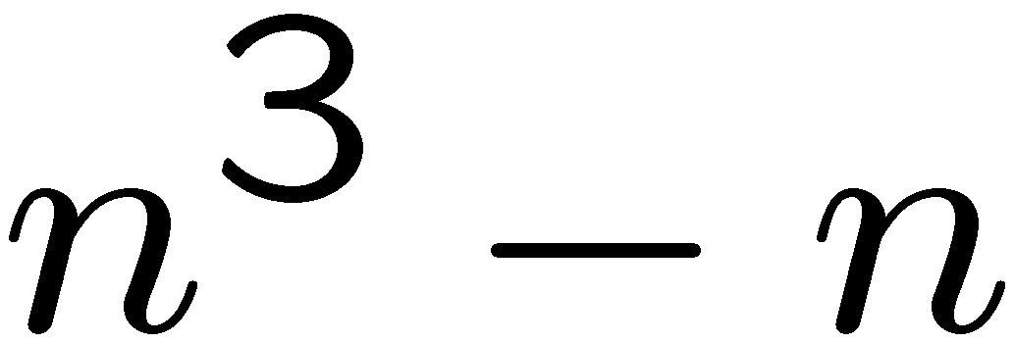
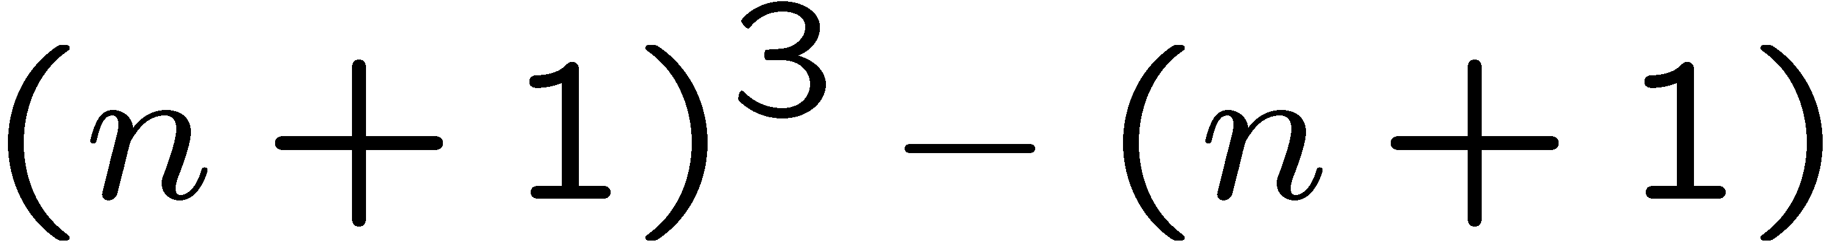
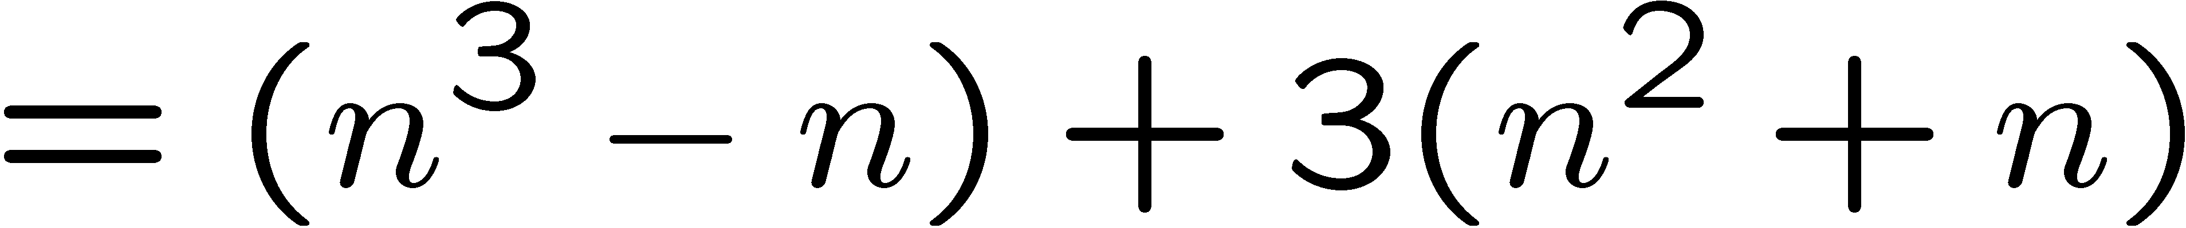
Proving a Property
Base Case (n = 2):
Induction Step: Assume P(i) for some i ≥ 2 and prove P(i + 1):
Assume
is divisible by 6
Prove
is divisible by 6.
Divisible by 6
by induction
Divisible by 2
by case analysis

Slide 8
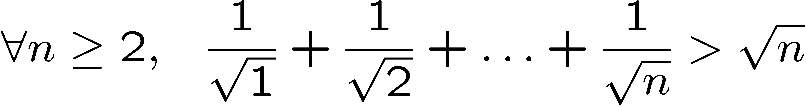
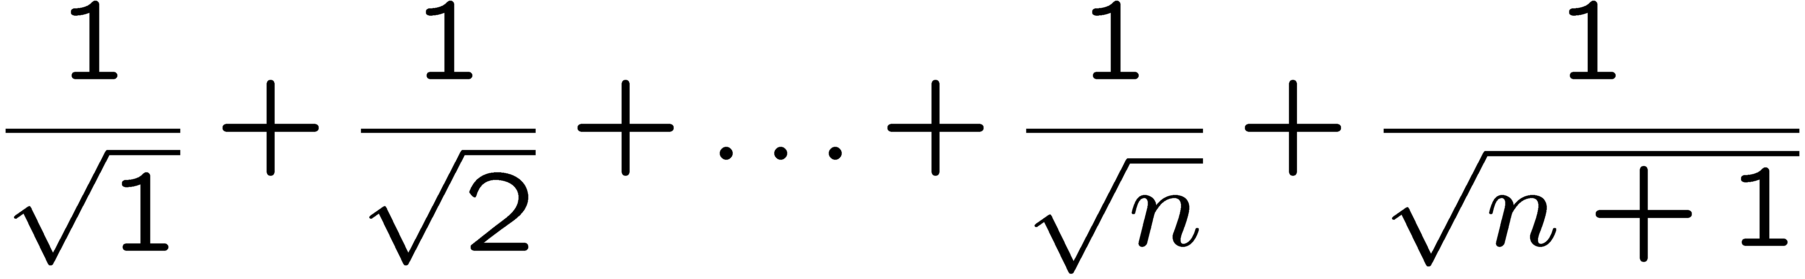
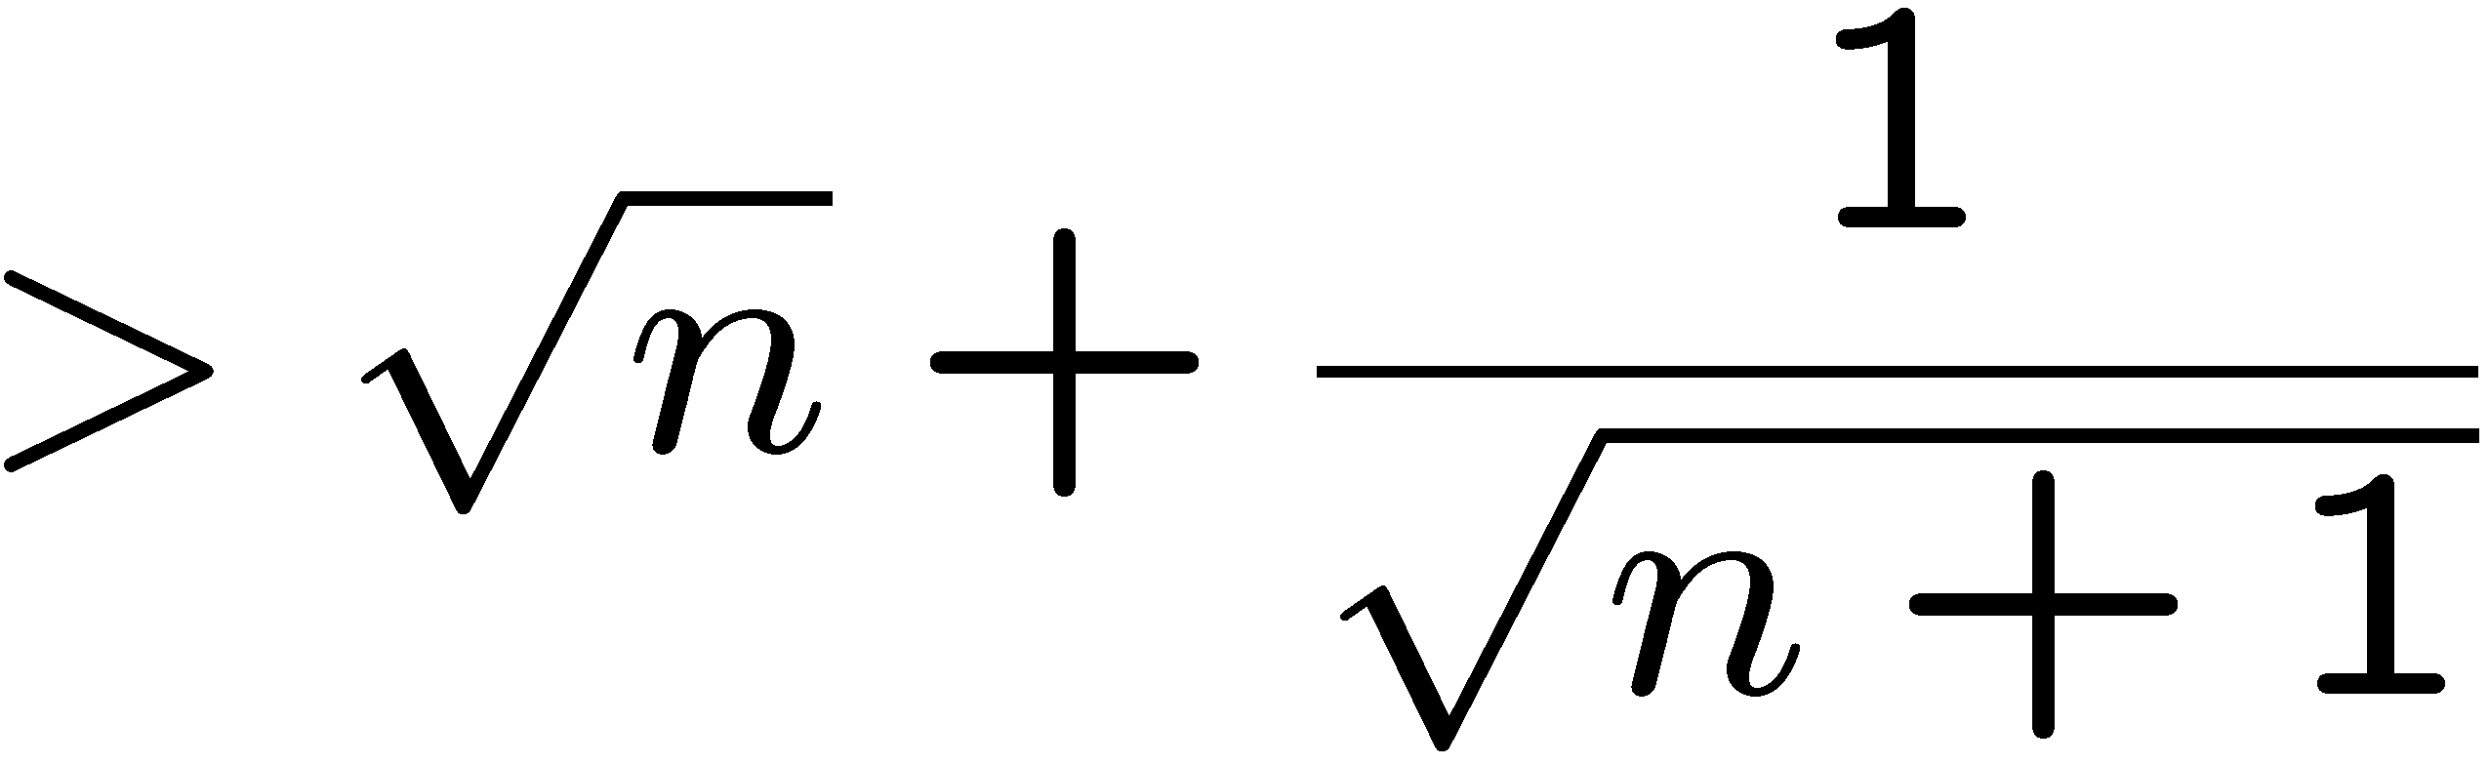
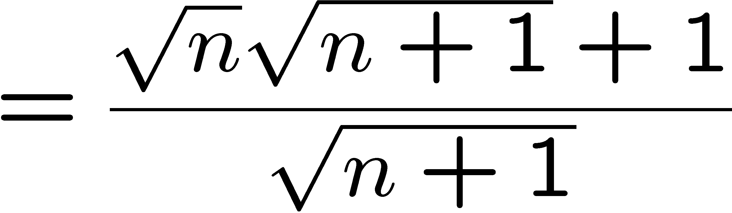
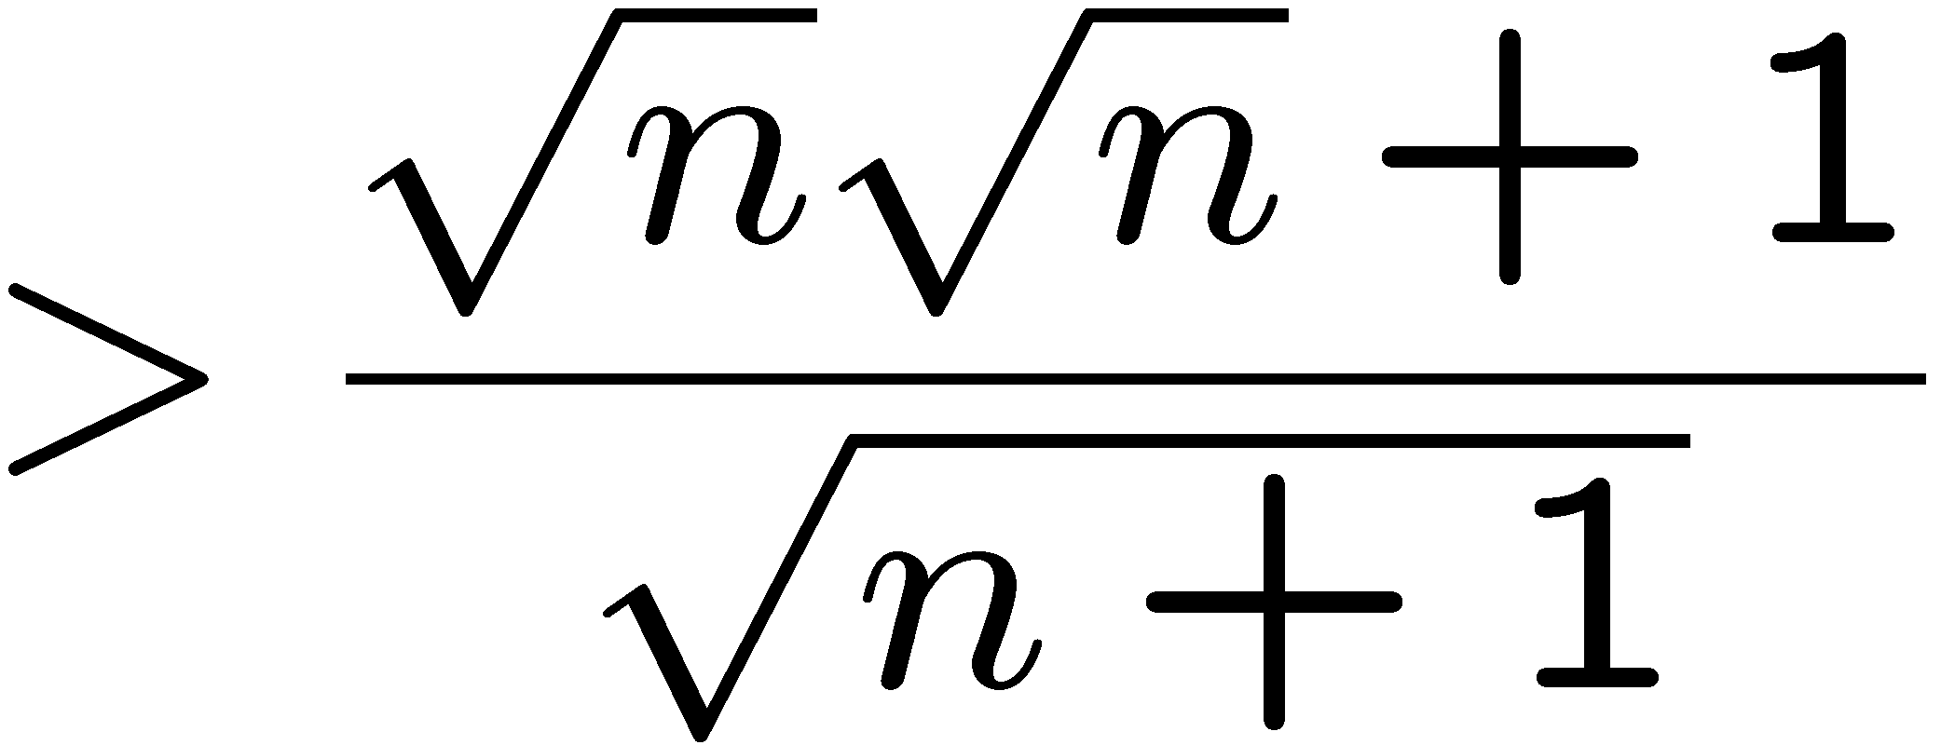
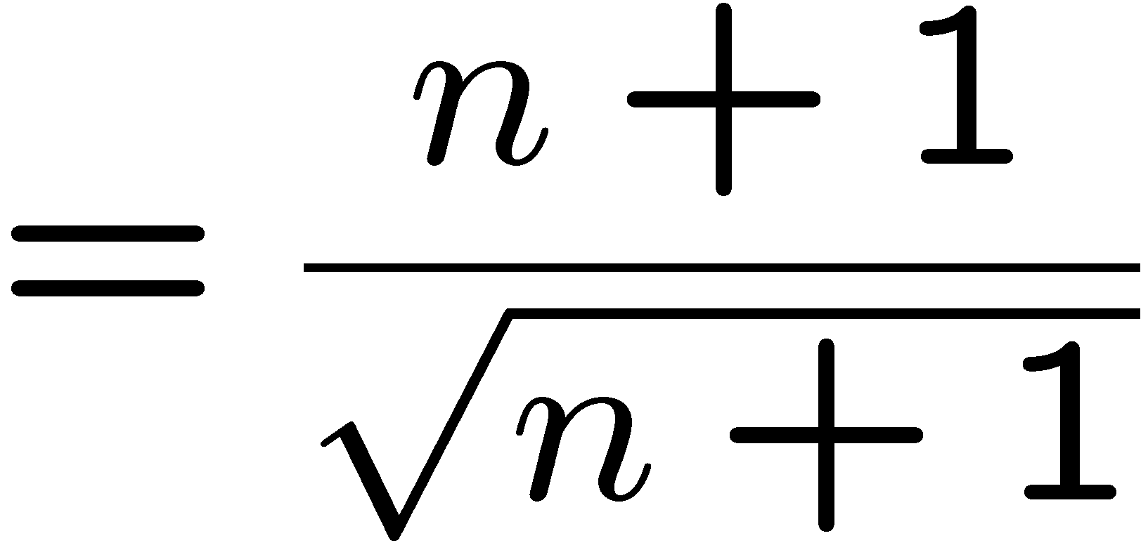

Proving an Inequality
Base Case (n = 2): is true
Induction Step: Assume P(i) for some i ≥ 2 and prove P(i + 1):
by induction

Slide 9
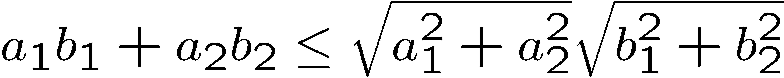
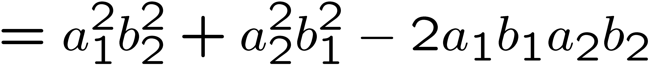
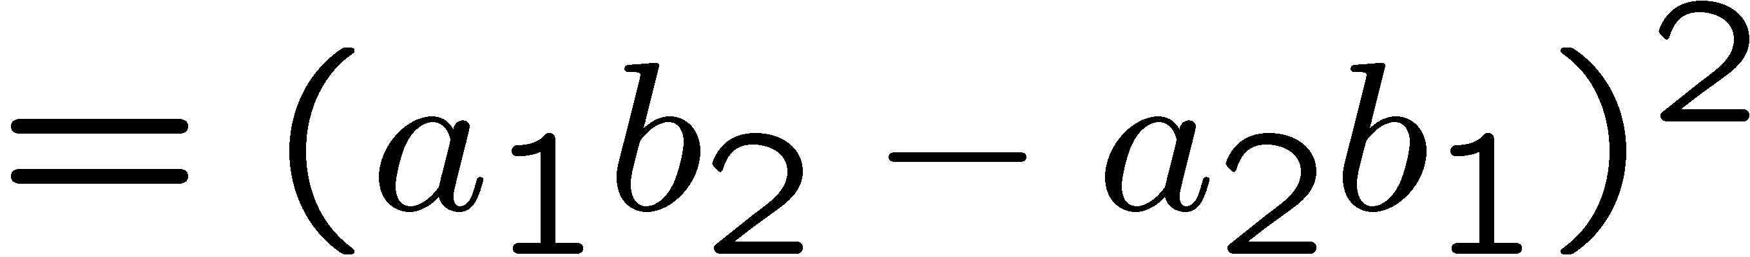
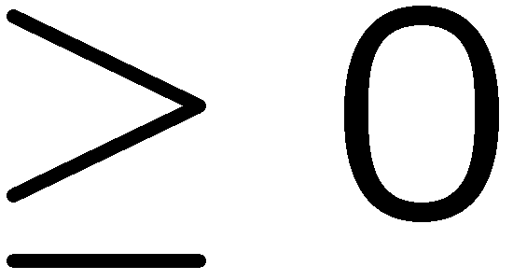
Cauchy-Schwarz
(Cauchy-Schwarz inequality) For any a₁,…,a_{n}, and any b₁,…b_{n}
Proof by induction (on n):
When n=1, LHS <= RHS.
When n=2, want to show
Consider

Slide 10

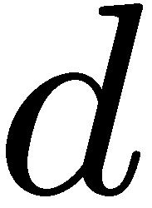
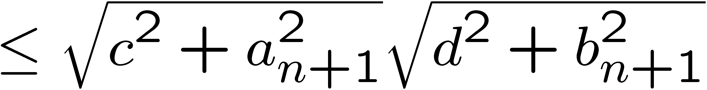
Cauchy-Schwarz
(Cauchy-Schwarz inequality) For any a₁,…,a_{n}, and any b₁,…b_{n}
Induction step: assume true for <=n, prove n+1.
induction
by P(2)

Slide 11
Quick Summary
You should understand the principle of mathematical induction well,
and do basic induction proofs like
  proving equality
  proving inequality
  proving property
Mathematical induction has a wide range of applications in computer science.

